Slide 1

ICCAT Workshop: investigation into bycatch estimation methodologies
Example use of tool based on simulated data
Facilitators:
Dr. Beth Babcock
Dr. Ana Adao

Slide 2
Example use of tool based on simulated data sets
2 main functions to interact with:
"bycatchSetup"
"bycatchFit"
Open up R script "LLSIM_example.R"
Notes:
"bycatchSetup" - data specification section of Users Guide
Results of "bycatchSetup" (Reviewing the Model setup section on Users Guide)
"bycatchFit" - model specification section of Users Guide
Results of "bycatchFit" (Main Analysis section on Users Guide)

Slide 3
R libraries
Make sure you have installed and loaded the following libraries:
>library(BycatchEstimator)
>library(MuMIn)

Slide 4
Simulated data example – BycatchSetUp function
Look at help file for "BycatchSetUp" function
Look at R code:
SetupObjTrip <- bycatchSetup (…)

Slide 5
Simulated data example – BycatchSetUp function
(Go through each argument of the function BycatchSetUp)
Give the names of the variables in the observer and logbook data files
If the simplest model requires stratification variables other than year, summaries of the predicted bycatch at the level of these stratification will printed in the csv files
Abundance indices will be calculated including all the variables requested in "indexModel"

Slide 6
Simulated data example – BycatchSetUp function
You may specify which predictor variables should be interpreted as a factor in "factorNames"
Note that year can be either a number or a factor; if year is a number, then a model such as y ~ Year will estimate a linear trend across years
Polynomial regression may be useful to estimate more complex trends across years in data sets where not all years have enough data to estimate Year as a categorical fixed effect; this can be:
Y ~ Year + I(Year^2) + I(Year^3)

Slide 7
Simulated data example – BycatchSetUp function
If pooling is requested (for the design-based estimators), the strata will be pooled in the order of "designVars"
Three additional vectors are needed to define how the pooling works:
"poolTypes": whether the variable should be pooled across adjacent levels (for Year only), all values, or a new variable (e.g. season rather than month)
"pooledVar": specifies the new variable for pooling
"adjacentNum": specifies the number of adjacent years to include
Each of these vectors must be the same length as "designVars"
You must also specify the minimum number of sample units in a stratum to require pooling ("minStrataUnit")

Slide 8
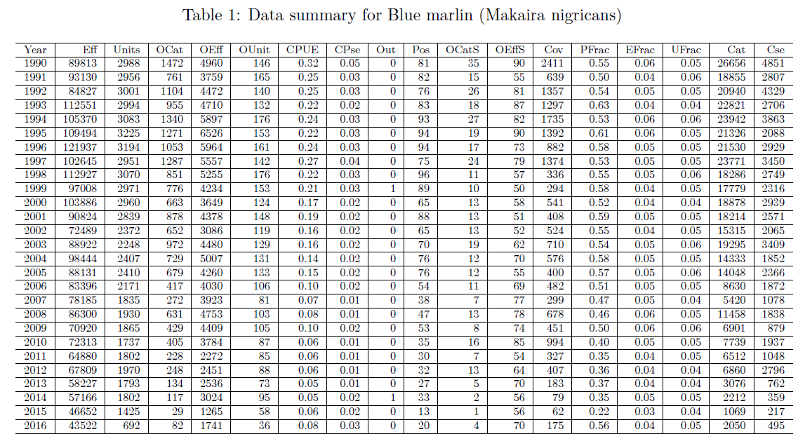
BycatchSetUp function - Outputs

Slide 9
BycatchSetUp function - Outputs
The design-based estimators are calculated when "bycatchSetUp" is run, so you may stop here if you only need the design-based estimators
They are given in the csv files "designYear" and "designStrata"

Slide 10
Simulated data example – BycatchFit function
Look at help file for "BycatchFit" function
Look at R code:
bycatchFit (setupObj = setupObjTrip, …)

Slide 11
Simulated data example – BycatchFit function
(Go through each argument of the function BycatchFit)
Specify whether to do cross validation to choose between observation error models ("DoCrossValidation") and whether to use the dredge function to choose the best set of predictor variables ("DredgeCrossValidation")
"ResidualTest" allows excluding from cross validation any model that fails the DHARMa residuals test; if none of the models perform well, this may be too restrictive, and it only works for small data sets

Slide 12
Simulated data example – BycatchFit function
If you have information on total bycatch in each year to validate your estimates, fill out the arguments "plotValidation", "trueVals" and "trueCols"

Slide 13
BycatchFit function - Outputs
The outputs all go into directories labelled with the species names, and include a pdf of all results (Ex: "Blue marlin catch results.pdf"), separate csv files for all the tables and separate pdfs with residual plots
"Modelfail.csv":
"-" for models that converged successfully
"data" for models that could not be fit due to insufficient data
"fit" for models that failed to converge
"cv" for models that produced results with high CVs (>10) in the annual catch predictions
"resid" for models that failed residuals test
If you get one of these errors for a model you want to use, you should check the data for missing combinations of predictor variables, extreme outliers, or years with too few positive observations

Slide 14
BycatchFit function - Outputs
Table 1: Input data summary (similar to table in "bycatchSetUp")
Table 2: Formula for best model (from comparison of IC); results of cross validation
Table 3: Model diagnostics (residual test, dispersion test, zero inflation test, outlier test)

Slide 15
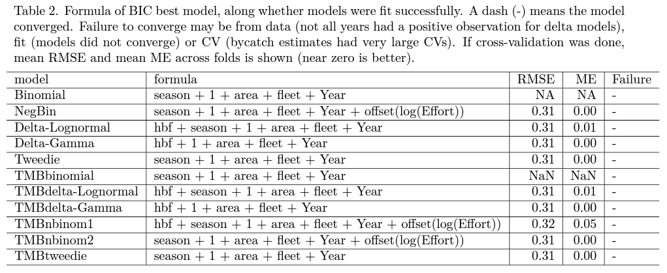
BycatchFit function - Outputs

Slide 16
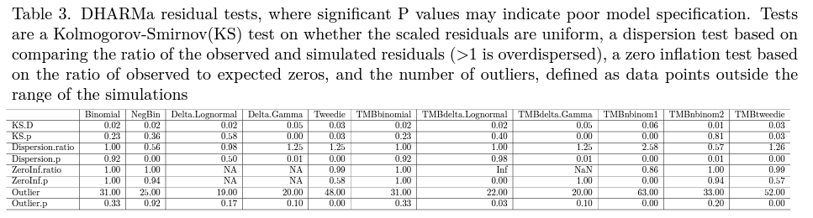
BycatchFit function - Outputs

Slide 17
BycatchFit function - Outputs
Figure 1: Total bycatch estimated for all models (design-based and model-based estimates)
Figure 2: Abundance indices from all models
Figure 3: Boxplots of model comparison with cross-validation

Slide 18
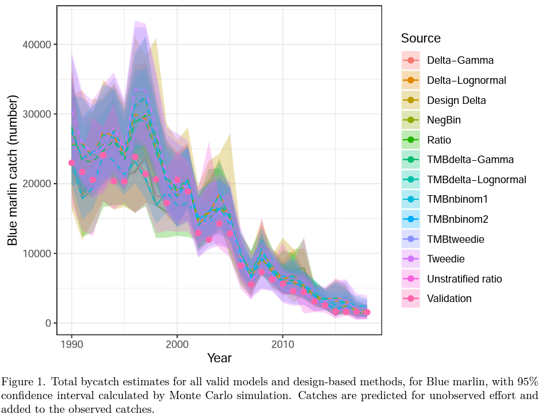
BycatchFit function - Outputs

Slide 19
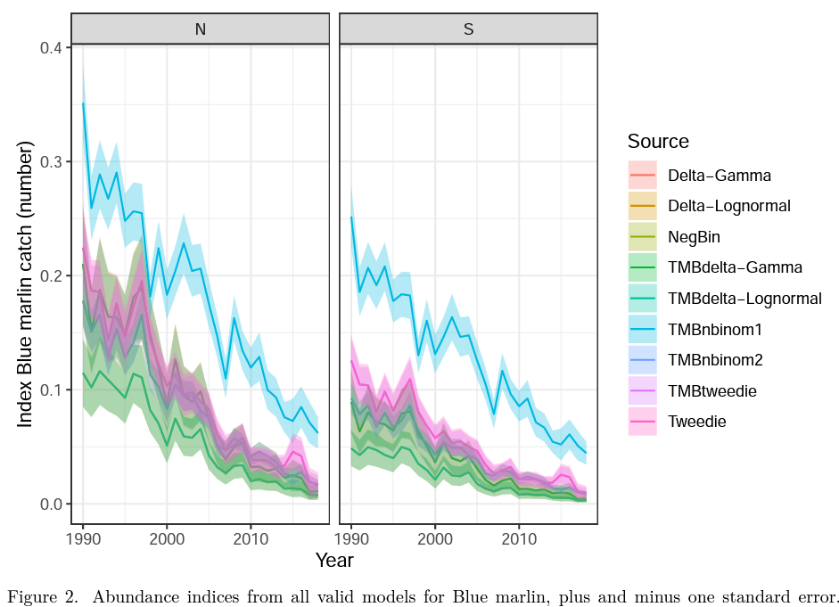
BycatchFit function - Outputs

Slide 20
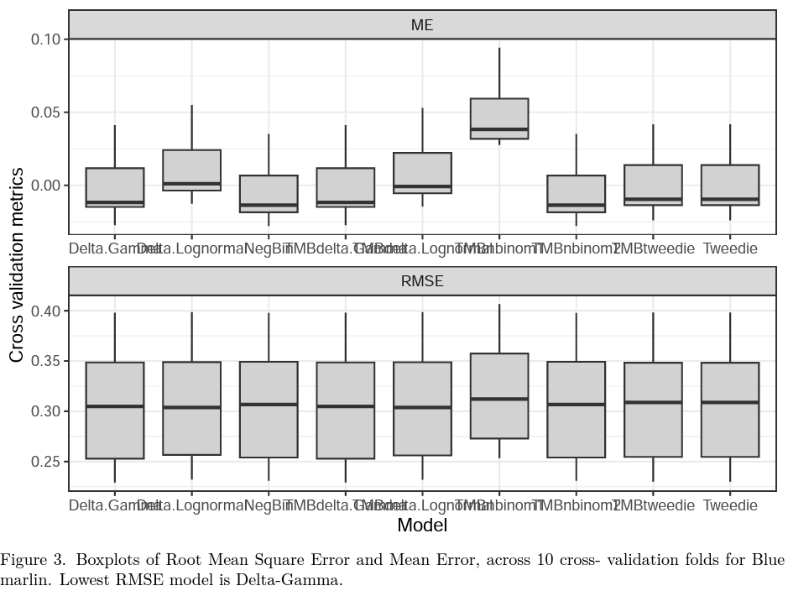
BycatchFit function - Outputs

Slide 21
BycatchFit function - Outputs
For each observation error model:
Table 4: model selection based on information criteria (IC)
Figure 4: model diagnostic plots (ordinary residuals and DHARMa residuals)
Figure 5: Estimated total bycatch (with confidence intervals if variance is calculated)
Figure 6: Estimated relative abundance index (with confidence intervals)

Slide 22
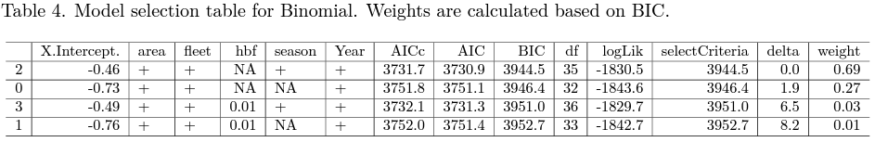
BycatchFit function - Outputs

Slide 23
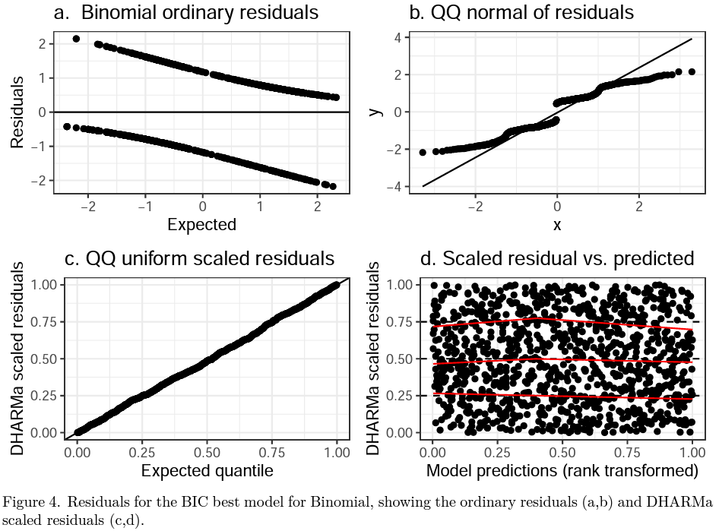
BycatchFit function - Outputs

Slide 24
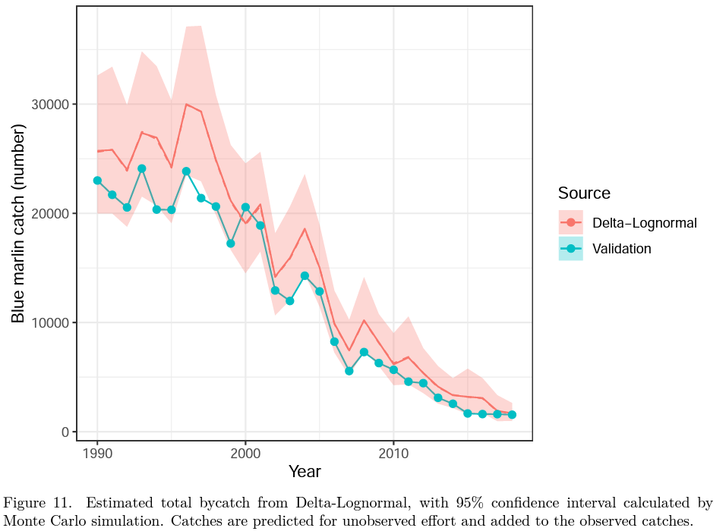
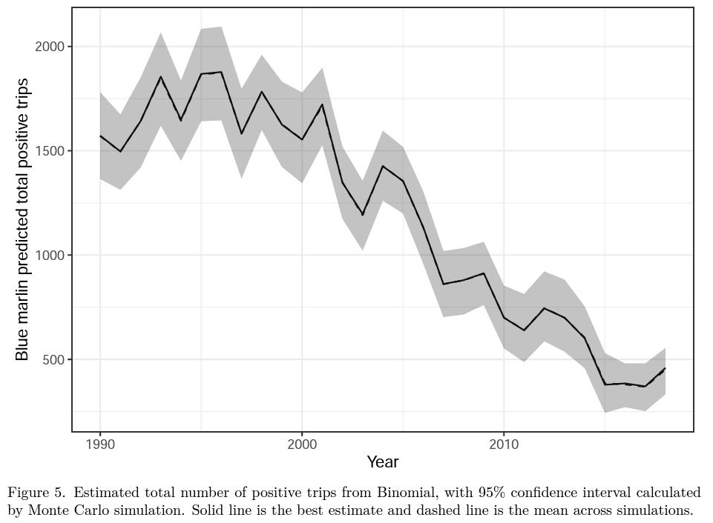
BycatchFit function - Outputs
Figures 5 and 11: Estimated total bycatch

Slide 25
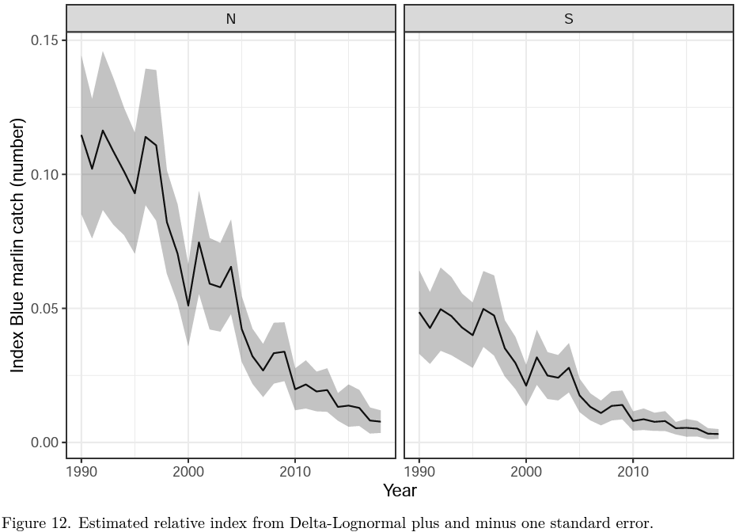
BycatchFit function - Outputs
Figure 12: Estimated relative abundance index

